Slide 1


Microsoft Security Stack : Overview

Slide 2
Zero Trust Principles
Verify Explicitly
Use Least Privileged Access
Assume Breach
Always authenticate and authorize based on all available data points, including user identity, location, device health, service or workload, data classification, and anomalies.
Limit user access with just-in-time and just-enough-access (JIT/JEA), risk-based adaptive polices, and data protection to help secure both data and productivity.
Minimize blast radius and segment access. Verify end-to-end encryption and use analytics to get visibility, drive threat detection, and improve defenses.

Slide 3
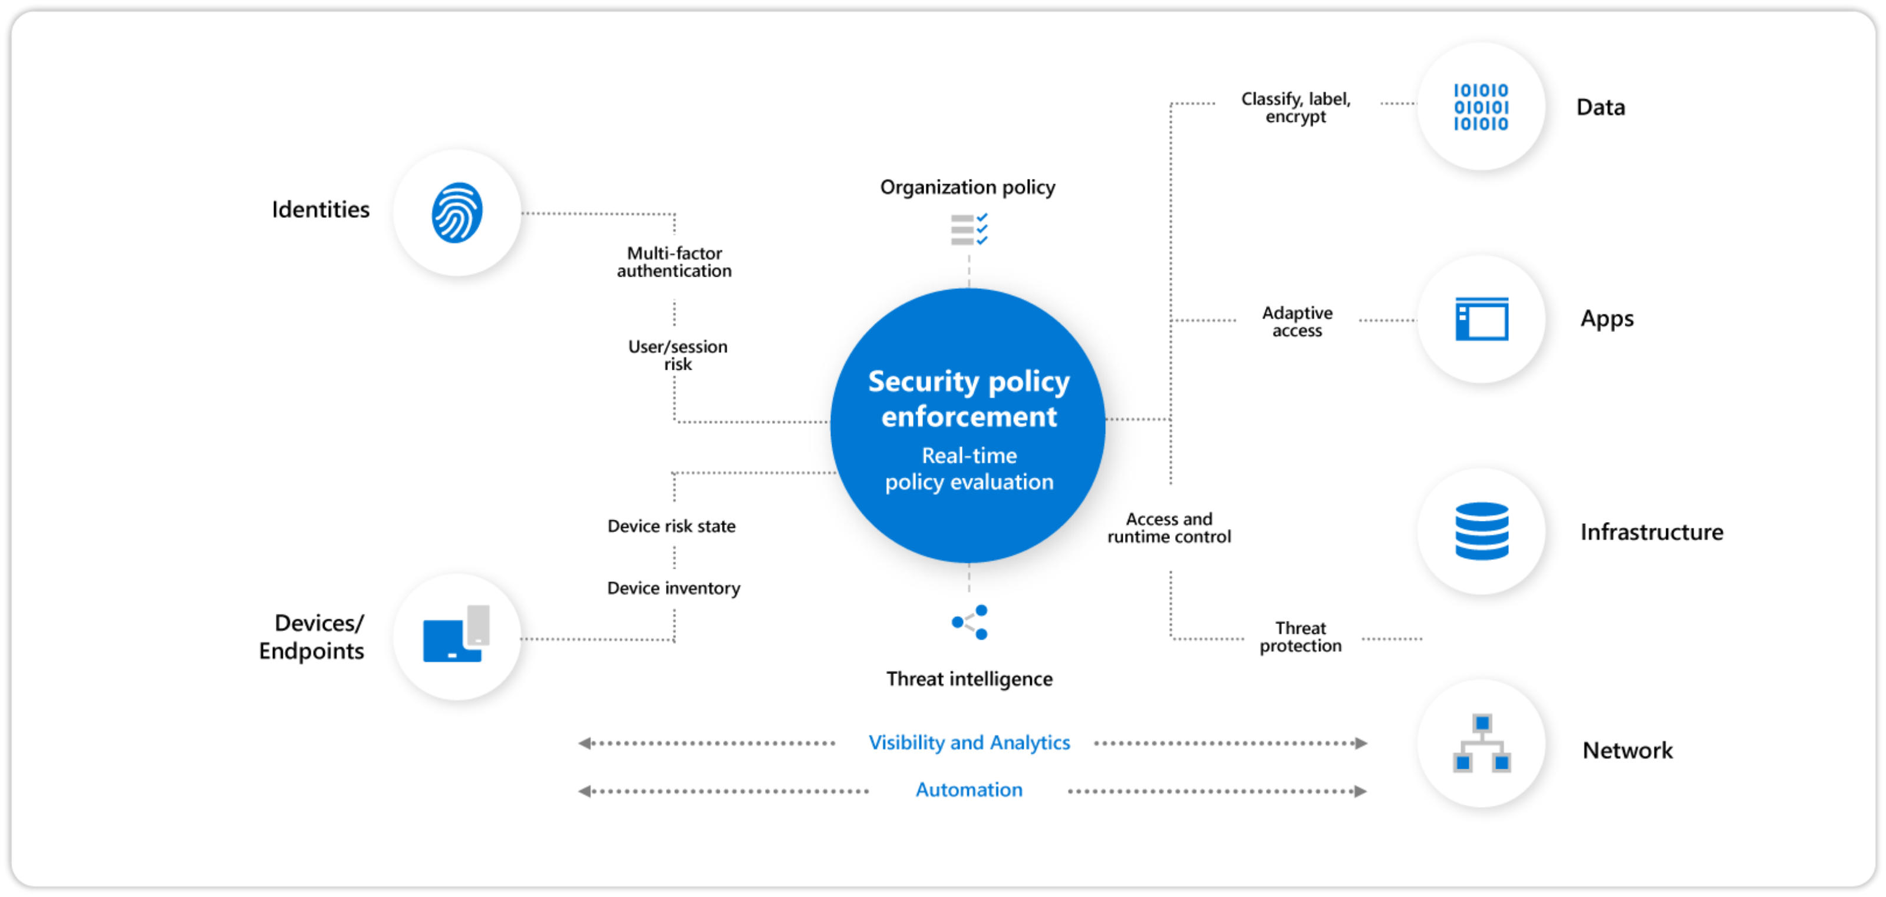

Slide 4
Microsoft Sentinel
The Core of Microsoft Security Stack
It’s SIEM and a bit More
It does Log Ingestion & Log Analytics
It does Automation & Response
Talk About : Connectors, FW Logs/Collector, Log Analytics Workspace, Analytics Rules / KQL

Slide 5
Microsoft Defender for Endpoint
Microsoft’s XDR (Extended Detection and Response) solution
Advanced Hunting using KQL
Automated Investigation and Response (AIR)
Threat and Vulnerability Management (TVM)
Talk About : MDE Sensors, Scan/Blocks/Isolation, Android/IOS/MAC/Linux support

Slide 6
Microsoft Endpoint Manager
Devices can be onboarded here. Connected to AAD and MDE.
Deploy Endpoint Security policies (Device Security) from here.
Attack Surface Reduction
Deploy and Measure Device compliance policies.
Talk About: Intune, Configuration Manager.

Slide 7
Microsoft Defender for Office
XDR Solution, particularly for Office 365 applications
View the email flow and anomalous activities (phishing campaign).
Security Awareness “like” function (Attack simulation training).
Deploy policy and rules.
Talk About : Microsoft Purview [ DLP, Information Protection ETC]

Slide 8
Microsoft Defender for CloudApps [Formerly knows as Microsoft CloudApp Security, AKA MCAS]
Microsoft’s Cloud Access Security Broker (CASB)
Visibility into and control over user activities and sensitive data in Microsoft Cloud and many others.
Understand your overall cloud posture across SaaS apps and cloud services.
Shadow IT discovery and app governance are key use cases.

Slide 9
Defender for Identity [Formerly Azure Advanced Threat Protection, also known as Azure ATP]
Leverages your on-premises Active Directory signals to identify, detect, and investigate advanced threats, compromised identities, and malicious insider actions directed at your organization.
Needs sensors installed on Domain Controllers.

Slide 10
AAD Identity Protection
Works at the back-end of Azure Active Directory [Now part of Microsoft Entra]
Focus on Automated risk detection and response.
Each sign in is validated to determine user and sign in risk.
Its Plug and Play service.

Slide 11
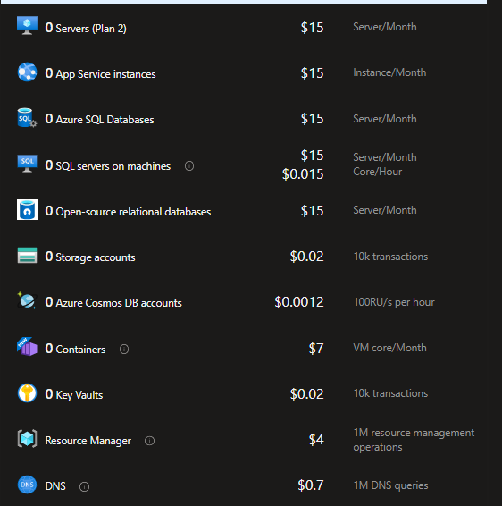
Defender for Cloud [ Formerly known as Azure Security Center ]
Security for cloud workloads in Multi-cloud environments.
Helps meet compliance and regulation requirements.
Useful recommendations on Security Posture Improvements.

